Slide 1
Solution
A solution is a homogeneous mixture of two or more substances, which may be solids, liquids, or gases, or a combination of these.
The solvent is the component present in the greatest quantity, in which the solute is dissolved.
Some examples of solutions include:
solid/solid: metal alloy such as brass (copper and zinc);
solid/liquid: seawater (salts and water), copper sulfate(aq) (copper sulfate and water);
liquid/liquid: wine (ethanol and water);
gas/liquid: fizzy drinks (carbon dioxide and water).

Slide 2
Concentration of solution
For solutions, we express the amount through its concentration. The concentration of a solution (c) is determined by the amount of solute (n) and the volume of solution (V).
It is usually expressed as mol dm^{–3}.
concentration of solution (mol dm^{–3})
= amount of solute (mol)/volume of solution (dm³) or c = n/V
amount of solute (mol) = conc. (mol dm^{–3}) × volume (dm³) or n = cV
Square brackets are often used to represent ‘concentration of’ a particular substance; such as [HCl] = 1.0 mol dm^{–3}.

Slide 3
Exercise
Eg1. What mass of oxalic acid, H2 C2 O 4 in required to make 250 cm 3 of a 0.0500 mol dm -3 solution?
Eg2. For the dissociation of Na2 SO4 , Na2 SO4 (aq) → 2Na ⁺ (aq) + SO 4 ²⁻ (aq)，[Na2SO4] = 0.03 mol dm ⁻³
what is concentration of Na⁺ and SO4 ²⁻?
Eg3. To prepare a solution containing [H+ ] = 0.050 mol dm-3 , what amount of H2 SO4 in required? The volume of solution is 200 dm3 .

Slide 4
Correct answer :B
1.7 g of NaNO₃ (M_{r} = 85) is dissolved in water to prepare 0.20 dm³ of solution. What is the concentration of the resulting solution in mol dm^{–3}?
A. 0.01
B. 0.1
C. 0.2
D. 1.0

Slide 5
Correct answer :C
What is the concentration of NaCl, in mol dm^{–3}, when 10.0 cm³ of 0.200 mol dm^{–3} NaCl solution is added to 30.0 cm³ of 0.600 mol dm^{–3} NaCl solution?
A. 0.450
B. 0.300
C. 0.500
D. 0.800

Slide 6
Calculation example
17.0 cm³ of 0.880 mol dm^{–3} lead(II) nitrate is added to excess sodium hydroxide solution to produce a precipitate of lead(II) hydroxide. Calculate the mass of precipitate formed, given that the equation for this reaction is:
Pb(NO₃)₂(aq) + 2NaOH(aq)→ Pb(OH)₂(s) +2NaNO₃(aq)
Solution
n(Pb(NO₃)₂) = c × V = 0.880 × 0.0170 = 1.496 × 10^{–2} mol
n(Pb(OH)₂) = n(Pb(NO₃)₂)
∴ m(Pb(OH)₂) = n × M = 1.496 × 10^{–2} × 241.21 = 3.61 g

Slide 7
Dilution of solution
Dilution: adding distilled water to the stock solution (concentrated solution) to form a diluted solution.
In the process, the amount of the solute remains the same (does not change). The volume of the solution increases, so the concentration decreases.
C1 V1 =C2 V2

Slide 8
Exercise
Eg1. 10.0 cm ³ of 1.50 mol dm ⁻³ H2 SO 4 solution is added by water to make a 200 cm³ solution, determine the concentration of diluted H2 SO 4 solution.
Hints: If the units of volume of solutions are same, there is no need to convert the volume into dm ³ because it’s a ratio.
Eg2. A CaCl 2 solution with the concentration of 0.100 mol dm ⁻³ is diluted by a factor of 5. Calculate the concentration after the dilution.

Slide 9
Standard Solution
Chemists routinely prepare solutions of known concentration, known as standard solutions.
The mass of solute required is accurately measured and then transferred carefully to a volumetric flask, which is accurately calibrated for a specific volume.
The solvent is added steadily with swirling to help the solute to dissolve, until the final level reaches the mark on the flask horizontally.

Slide 13
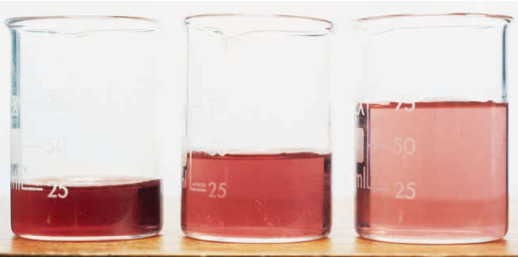
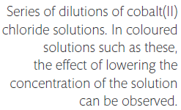
Dilutions of solutions

Slide 14
Dilutions of solutions
A common practice in laboratory work is to make a dilution from a more concentrated starting solution by adding solvent.
For all aqueous solutions, distilled water, rather than tap water, must be used.
As a solution is diluted, the number of moles of solute remains the same, but as they become spread through a larger volume, the concentration is decreased.
In other words, the number of moles, n = a constant, and as n=cV , cV must be constant through dilution.
c₁V₁ = c₂V₂ where c₁ and V₁ refer to the initial concentration and volume and c₂ and V₂ refer to the diluted concentration and volume.
This equation provides an easy way to calculate concentration changes on dilution.

Slide 16
Volumetric Analysis
From the stoichiometry of the reaction, when we know the volumes of both solutions and the concentration of one of them, we can use the mole ratio to calculate the unknown concentration as follows.

Slide 17
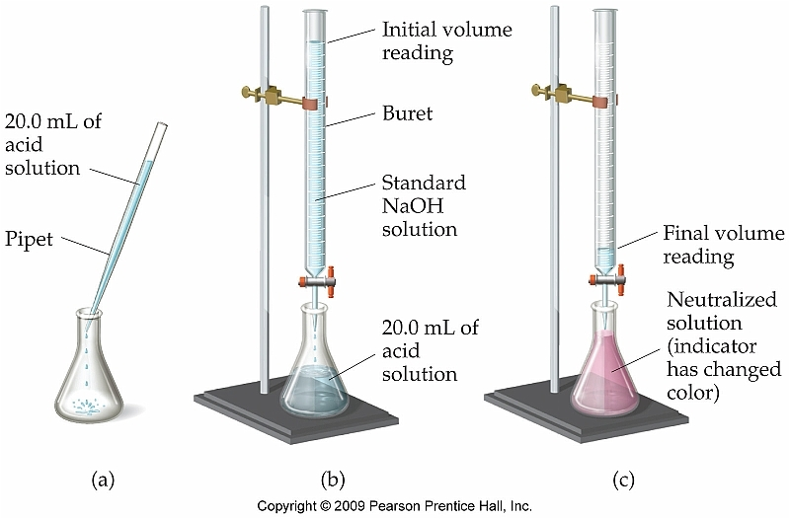
Titration

Slide 18
Titration
Most commonly, a technique called titration is used to determine the reacting volumes precisely.
A pipette is used to measure a known volume of one of the solutions into a conical flask.
The other solution is put into a burette, a calibrated glass tube that can deliver precise volumes into the conical flask through opening the tap at the bottom.
The point at which the two solutions have reacted completely, the equivalence point, is usually determined by an indicator that is added to the solution in the conical flask and changes colour at its end-point.
Different indicators are chosen for specific titrations, so that their end-point corresponds to the equivalence point of the titration.

Slide 19
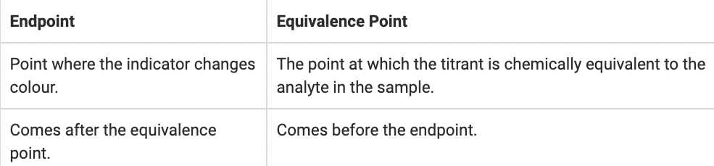
Titration usually involves multiple trials to obtain a more accurate result of the volume required to reach the equivalence point; this volume is known as the titre.
A good titration result is one that gives consistent results within 0.05 cm³ of each other.

Slide 21
Here is a summary of the steps in volumetric analysis calculations:
first write the equation for the reaction;
look for the reactant whose volume and concentration are given and calculate its number of moles from n = cV;
use this answer and the mole ratio in the equation to determine the number of moles of the other reactant;
use the number of moles and volume of the second reactant to calculate its concentration from c = n/V.

Slide 22
Back Titration
A back titration is done in reverse by returning to the end-point after it is passed.
It is used when the end-point is hard to identify or when one of the reactants is impure.
A known excess of one of the reagents is added to the reaction mixture, and the unreacted excess is then determined by titration against a standard solution.
By subtracting the amount of unreacted reactant from the original amount used, the reacting amount can be determined.

Slide 24
Note that there are several assumptions made in this calculation. These include the fact that all the NaHCO₃ did react with the acid, and that the only component of the tablet that reacted with HCl is NaHCO₃.
You may like to think how you could test the validity of these assumptions in the laboratory.

Slide 25
The quantity of organically bound nitrogen (org-N) released by acid digestion is referred to as Kjeldahl nitrogen. One method used to determine the Kjeldahl nitrogen content involves a back titration and is outlined below.
A 10.00 mL sample is diluted to 100 mL with distilled water.
A 25.00 mL aliquot of this diluted sample is pipetted into a digestion flask. 50.00 mL of 0.1011 M H2SO4 concentrated H2SO4 are added and the solution is heated for 45 mins (digestion). Under these conditions, all the organic nitrogen is converted to NH4 ⁺ .
Concentrated NaOH is added to neutralize the excess H2SO4 and to convert the NH4 ⁺ to NH3, The excess H2SO4 was determined by titration with 5.12 mL of 0.1266 M NaOH. What is the concentration of Kjeldahl nitrogen in the original sample?

Slide 26
A 0.723 g sample of chalk (largely calcium carbonate) was dissolved in 20.0 cm³ of 1.00 M hydrochloric acid. When the reaction was complete, the remaining acid was titrated with 0.500 M sodium hydroxide solution. The titre was 12.00 cm³.
What would be used to measure out the 20.0 cm³ of hydrochloric acid?
Assuming only the calcium carbonate reacts with the acid, what percentage of the chalk sample is calcium carbonate?

